Slide 1
Recap of Yesterday
Xamarin 101
Lots of issues getting the environment setup
If you get past that, mobile dev is straightforward

Slide 2

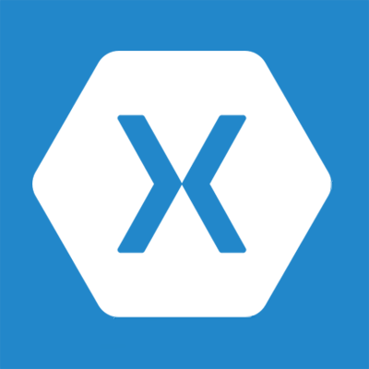
Your Options

Slide 3
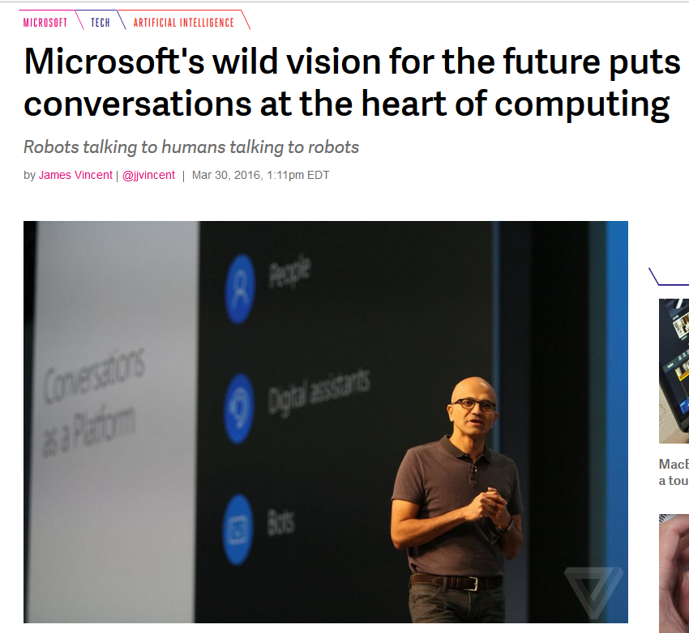

Slide 4
Conversations as a platform
Jay Janarthanan
Developer Experience Group
Microsoft New Zealand
Notes:
(Introductions and set expectations that this presentation is designed to discuss the role of Azure as the cloud computing platform for a business’s digital transformation.)

Slide 5
Create more personal computing
Build the intelligent cloud platform
Reinvent productivity & business processes
Notes:
We have three interconnected ambitions: build an intelligent cloud platform, create more personal computing, and reinvent productivity and business processes. At the intersection of these ambitions, is an emerging idea that we’re in the early days of making a reality. We call it conversations as a platform.
It's a simple, but powerful concept. It’s rooted in the most basic way we communicate, speech, and is about taking the power of human language and applying it more pervasively to all of our computing.
This new platform will enable us to interact with devices more intuitively, using natural language, conversations, evolving us from mechanical keyboard and mouse to touch and beyond, taking advantage of more human capabilities like our voice, pen, our face, gestures, fingerprints.

Slide 6

How do we get our computers to understand the real world?
Notes:
Why does more personal computing matter? We can an look at ourselves and make some general observations.
As humans, we can make sense of our very analog world. We're constantly making decisions based on the input that we receive from all around us.: sounds, sights, smells, our sense of touch. We understand that someone may want attention when they raise their hand. Or needs a moment of privacy when they are talking on a phone.
Our ability to contextually understand people, objects and environments is key to how we interact with the world. It is also key to how we discover, learn and make our world better.
The computers in front of you don't have much of this capability. And consequently for the last 30 years our devices have largely been regulated to helping us make binary decisions of 1s and 0s: True or false? Yes and no. Whether your Outlook calendar is free or busy. Our computers know nearly nothing about the world we inhabit.
And that's what we want to change with More Personal Computing.
For decades, those of us who make computers and, more specifically, software spent decades teaching people how to understand computers. We want to teach our computers how to better understand people. And not people, but also the objects and places that make up our world.
What happens when our computers, informed by myriad sensor networks, fusing data in the cloud from the sensor networks that surround us, become capable of understanding the world that we inhabit?
Image Source: https://download.unsplash.com/photo-1423882503395-8571951e45cc

Slide 7
People
Conversations as a Platform
Digital assistants
Bots
Notes:
This new platform includes a personal digital assistant knows you, knows about your world and is always with you across all your devices helping you with your everyday tasks. And bots, with the capability to take the power of human conversations, and apply it to everything.
We imagine a rich ecosystem of conversations, ones that include: people to people, people to your personal digital assistant, people to bots, and even personal digital assistants calling on bots on your behalf. That's the world that you're going to get to see in the years to come.

Slide 8
What is it
Think of Cortana / Siri / Google Assistant
Ability to use natural language to interact with technology
Bots, virtual assistants, etc
Enabled by Microsoft Bot Framework
Already available for Skype, Messenger, MS Teams, etc

Slide 9
The Idea behind bots
To communicate with bots in a natural way – all the information at our fingertips, without having to do extra work to search it, etc.

Slide 10
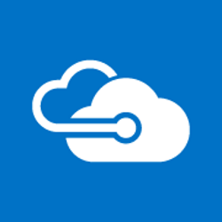

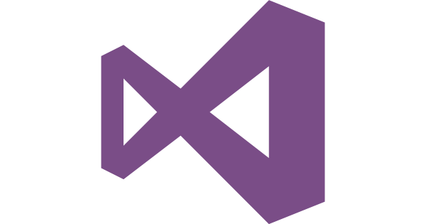
High Level Overview
Connected to API
API / Database
Built in Visual Studio
C# or NodeJS
Deployed to Azure
Consumed by Client

Slide 11







CaaP Technology Stack
Bots
Intelligent conversational application
3rd party
Microsoft
Agents
First-party conversational meta application
Cortana
Canvas
Platform for your bot or agent
Core Services
Building blocks for intelligent services
Azure
Bing
Bot Framework
Cognitive Services
Cortana Analytics
Office 365

Slide 12

microsoft.com/cognitive
Vision
Speech
Language
Knowledge
Search
Computer Vision
Custom Recognition
Bing Spell Check
Academic Knowledge
Bing
Web Search
Emotion
Speaker Recognition
Linguistic Analysis
Entity Linking
Bing
Image Search
Face
Speech
Language Understanding
Knowledge Exploration
Bing
Video Search
Video
Translator
Text Analytics
Recommendations
Bing
News Search
WebLM
Bing
Autosuggest
Notes:
Here’s a view of Cognitive Services with all the API and service names listed. Some of you probably recognize some of these name as being part of Proj. Oxford that we announced last year, as well as the previous public Bing APIs.
Let me be clear that this is not a simple rebrand of existing services. Since last year, we made significant updates, added new services that were a good fit, and eventually combined project oxford, bing, and translator as part of bringing together Cognitive services.
-------------------
Why choose these APIs? They work, and it’s easy.
Easy: The APIs are easy to implement because of the simple REST calls. Being REST APIs, there’s a common way to implement and you can get started with all of them for free simply by going to one place, one website, www.microsoft.com/cognitive. (You don’t have to hunt around to different places.)
Flexible: We’ve got a breadth of intelligence and knowledge APIs so developers will be able to find what intelligence feature they need; and importantly, they all work on whatever language, framework, or platform developers choose. So, devs can integrated into their apps—iOS, Android, Windows—using their own tools they know and love (such as python or node.js, etc.).
Tested: Tap into an ever-growing collection of powerful AI algorithms developed by experts. Developers can trust the quality and expertise build into each API by experts in their field from Microsoft’s Research organization, Bing, and Azure machine learning and these capabilities are used across many Microsoft first party products such as Cortana, Bing and Skype.

Slide 13
Some of the bots…
https://bots.botframework.com/

Slide 14
Let’s get technical! - Checklist
You’ve got Visual Studio Community or above
You’ve placed the zip file in your template folder
You’ve got the emulator installed
Is your Dreamspark Azure subscription still working?
Let’s go!

Slide 15
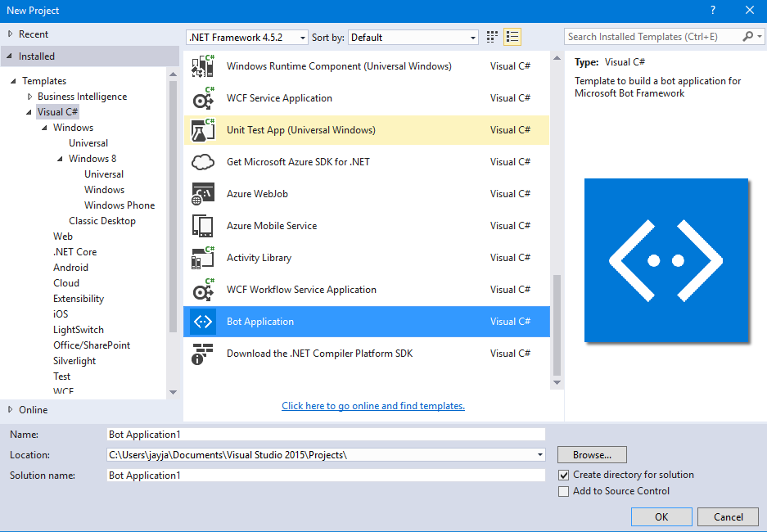
Building the basic bot
File > New Project > Visual C# > Bot Application

Slide 16
Create the bot
File > New Project > Visual C# > Bot Application

Slide 17
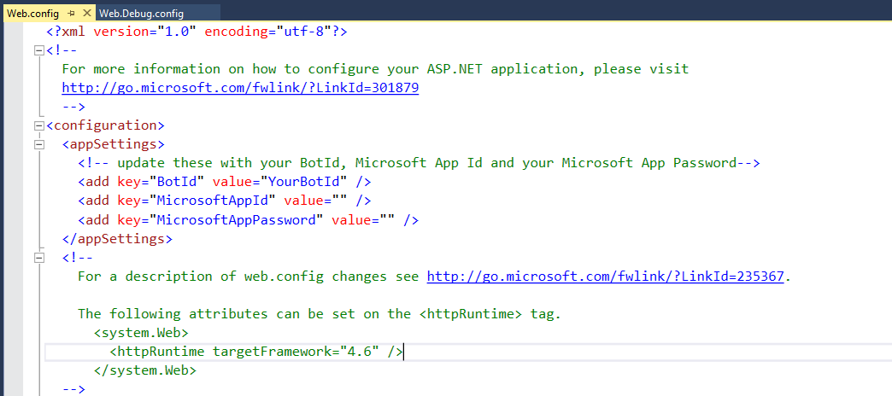
Let’s run it
1) Clear the App ID and App Secret in Web.config

Slide 18
Let’s run it
Press run (Use Edge / Chrome)
Note down the port number
Launch Microsoft Bot Framework Channel Emulator
Use http://localhost:<port>/api/messages
Leave APP ID, Password blank
Type something in, what happens?

Slide 19
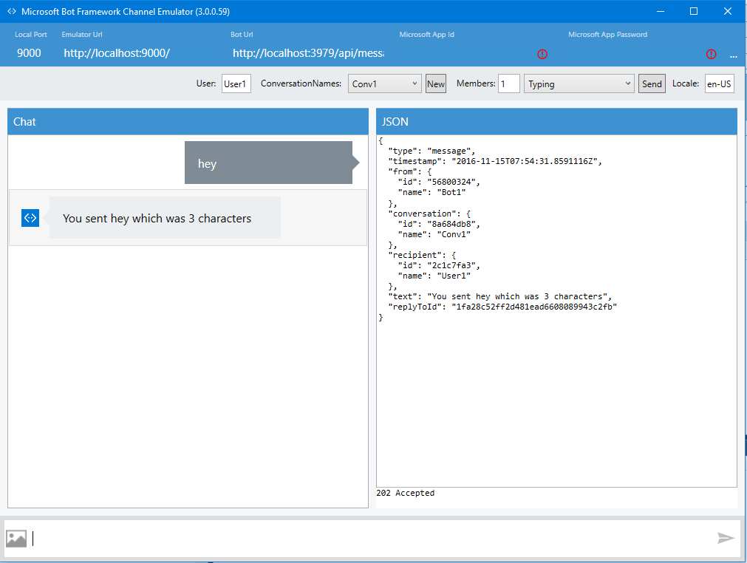

Slide 20
CHECKPOINT
Can everyone run the bot? Does it work?
Raise your hand if it doesn’t. Final call!

Slide 21
Let’s publish this…
This is a working app
It won’t meet the quality criteria for Facebook, Skype or anything else, but let’s get familiar with the Bot Framework process
Once published, we’ll look at some code

Slide 22
Let’s publish this…
This is a working app
It won’t meet the quality criteria for Facebook, Skype or anything else, but let’s get familiar with the Bot Framework process
Once published, we’ll look at some code

Slide 23
The Quality Factor…
This is a working app
It won’t meet the quality criteria for Facebook, Skype or anything else, but let’s get familiar with the Bot Framework process
Once published, we’ll look at some code

Slide 24
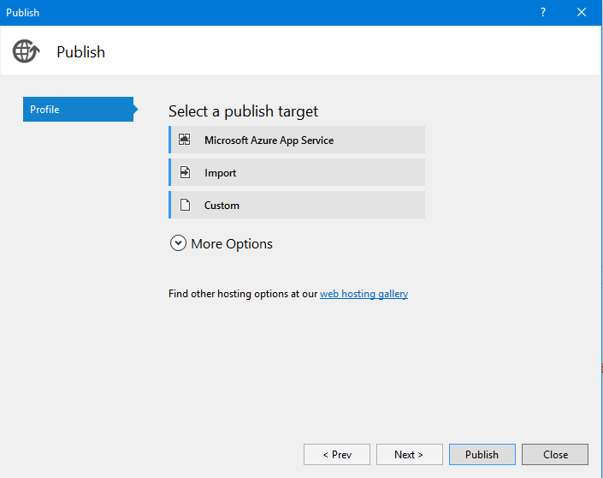

Slide 25
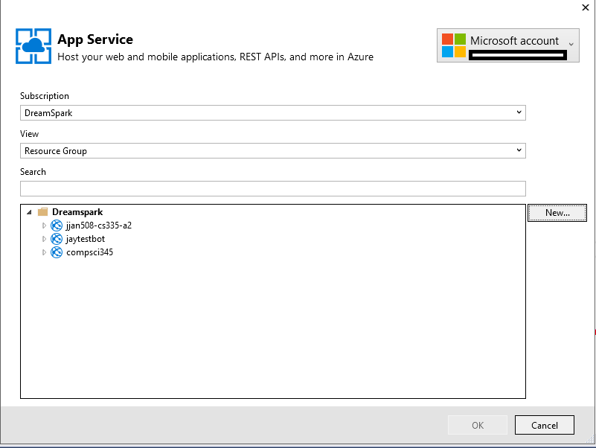

Slide 26
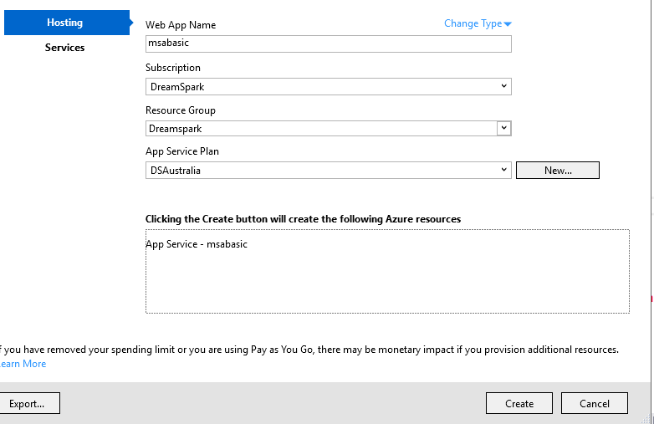

Slide 27
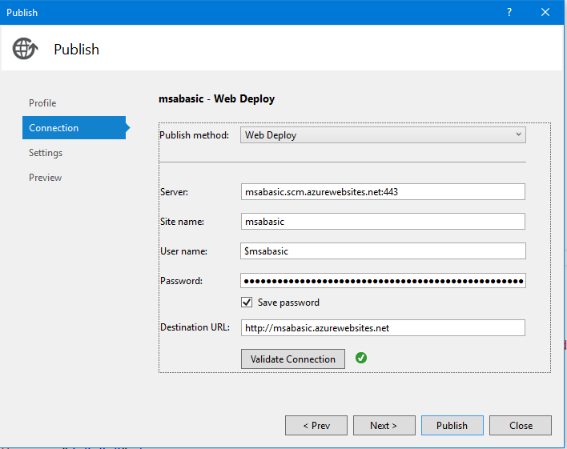
Publish when ready

Slide 29
http://msabasic.azurewebsites.net/
Let’s run this in the emulator

Slide 30
What problems do you face?
And what’s the solution?

Slide 31
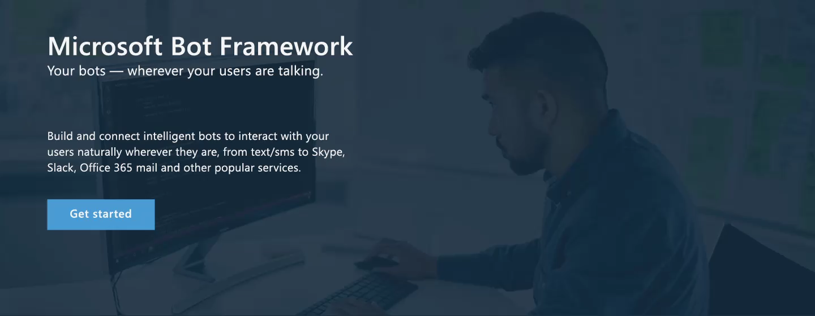
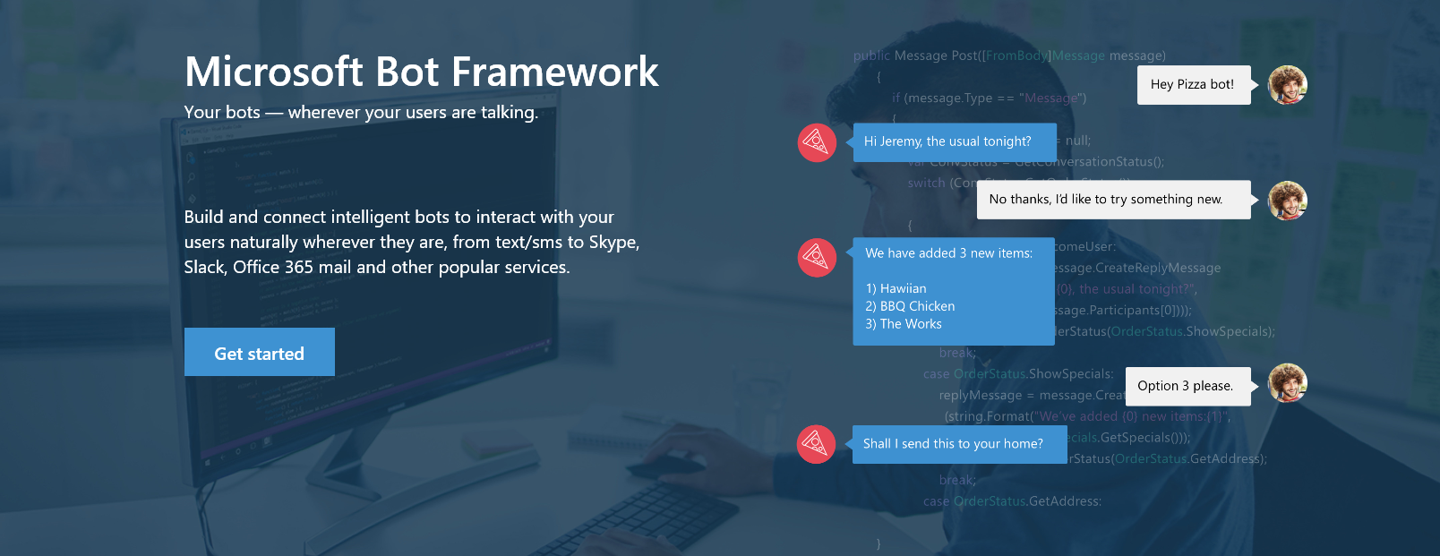

botframework.com
www.botframework.com
Notes:
So with all that talk about bots I want to introduce the Microsoft Bot Framework

Slide 32
Bot Registration
Fill out the fields
NOTE THE APP ID AND PASSWORD DOWN!
https! Not http.
Use the APP ID and password in your web.config and publish
Bot Name is your Bot ID in Microsoft Framework.

Slide 33
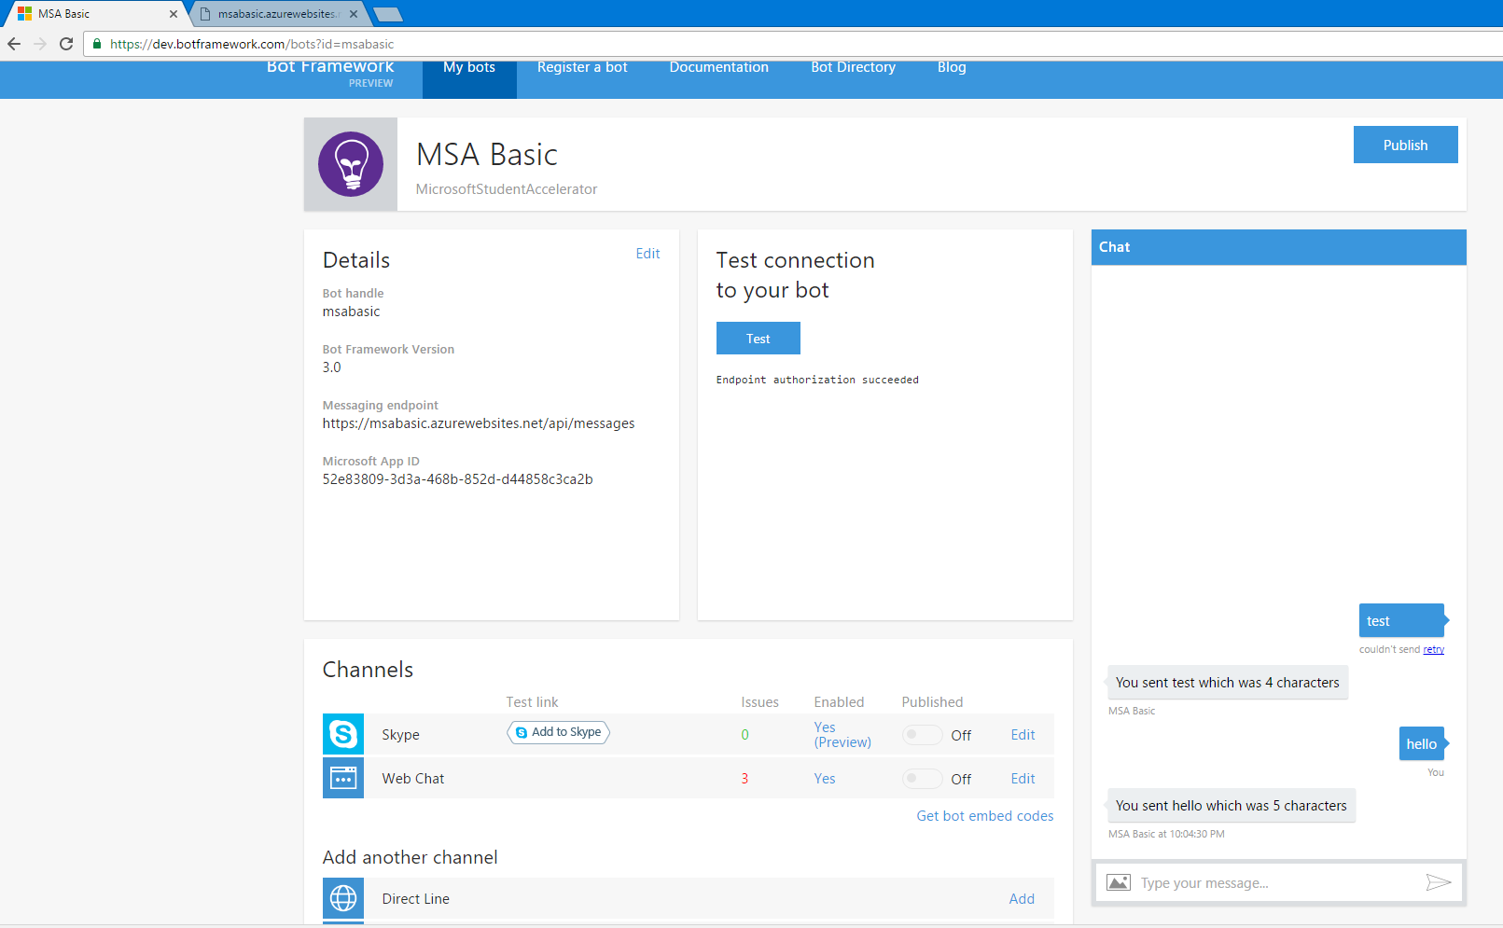

Slide 34
Uh Oh…
By this point, either you’re a genius or you’re getting a 401 / 404 / 405 / 500 error.
Check your web app is being called at /api/messages
https://blogs.msdn.microsoft.com/benjaminperkins/2016/08/01/bot-framework-405-method-not-allowed-401-unauthorized-and-500-internal-server-error-getting-started/

Slide 35
The error codes
Error | Reason
401 Unauthorised | Check your App ID, App Secret and if its https:// registered
404 Not Found | You are probably targeting the wrong thing
405 Method not allowed | Check if you’re calling /api/messages
500 Internal Error | Problem with your code – unlikely since it’s the demo Problem with the emulator, azure app, etc
Notes:
https://blogs.msdn.microsoft.com/benjaminperkins/2016/08/01/bot-framework-405-method-not-allowed-401-unauthorized-and-500-internal-server-error-getting-started/

Slide 36
Meet NGROK
https://ngrok.com/download
Enables us to connect to the cloud. This is due the change of needing to do auth callbacks to the emulator from the internet.
Download, run as admin, use this command:
ngrok http -host-header=rewrite 9000

Slide 37
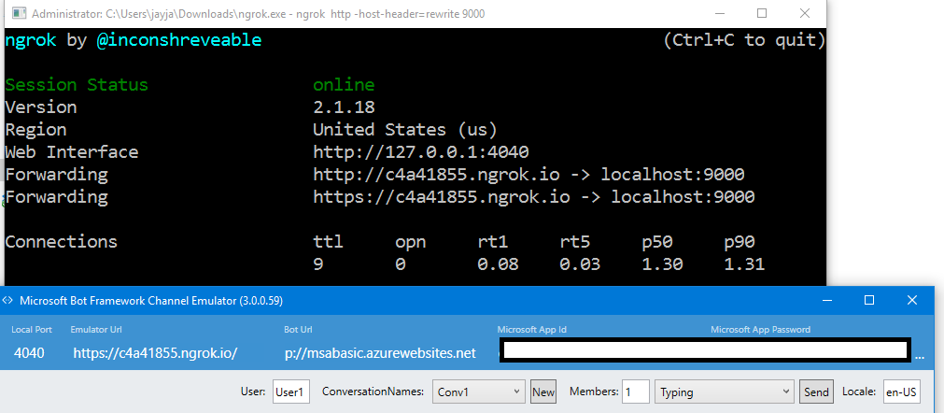

Slide 38
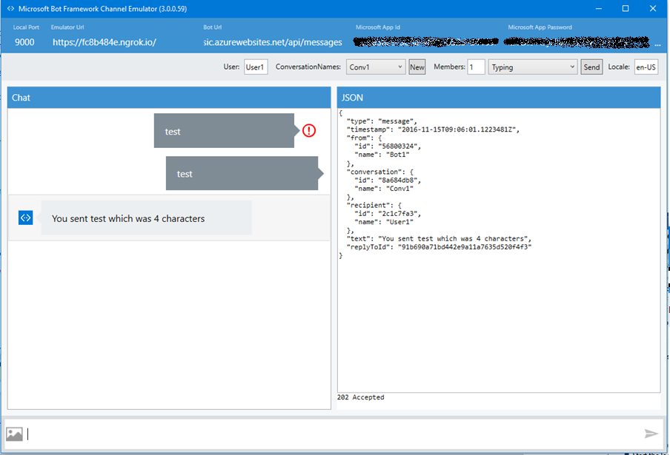

Slide 39
Now check…
Does it work?

Slide 40
We should be published!
Any questions?

